Slide 1

Final-BootCamp Project
Build and deploy a High Volume Streaming Data Ingestion Platform on AWS
Jorge Castro DAPT NOV 2021
19 May 2022

Slide 2
Objective: Build a data streaming platform in Python on AWS to simulate the ingestion of e-Commerce data, transform and store them on a DataWarehouse, on a Data Lake and on a non-relational database.

Slide 3

Data Source:
E-Commerce Data.
Actual transactions from UK retailer
Every row is an article or an item

Slide 4










Tools used:
Python
Power BI
API Gateway
Lambda Function
Kinesis Data Stream
Kinesis Firehose Delivery Streams
DynamoDB
S3 Storage
Glue
Redshift

Slide 5











High Volume Streaming Data Ingestion Platform on AWS
Response
Body = Rows
Visualization API
HTTP GET Request
Lambda Function
DynamoDB
Invoices Table
DynamoDB
Customers Table
Batch Processing Data Pipeline for Bulk Import
API Gateway
Python Client Simulation
Transactions Streaming
HTTP POST
Body = Rows
S3 Storage
Lambda Function
Power BI
Lambda Function
Glue Job (Spark)
Kinesis Data Stream
Lambda Function
Redshift Data Warehouse
Redshift Data Warehouse
S3 Temp Storage
Kinesis Firehose
Delivery Streams
S3 Storage
Data Lake
Raw Data

Slide 6
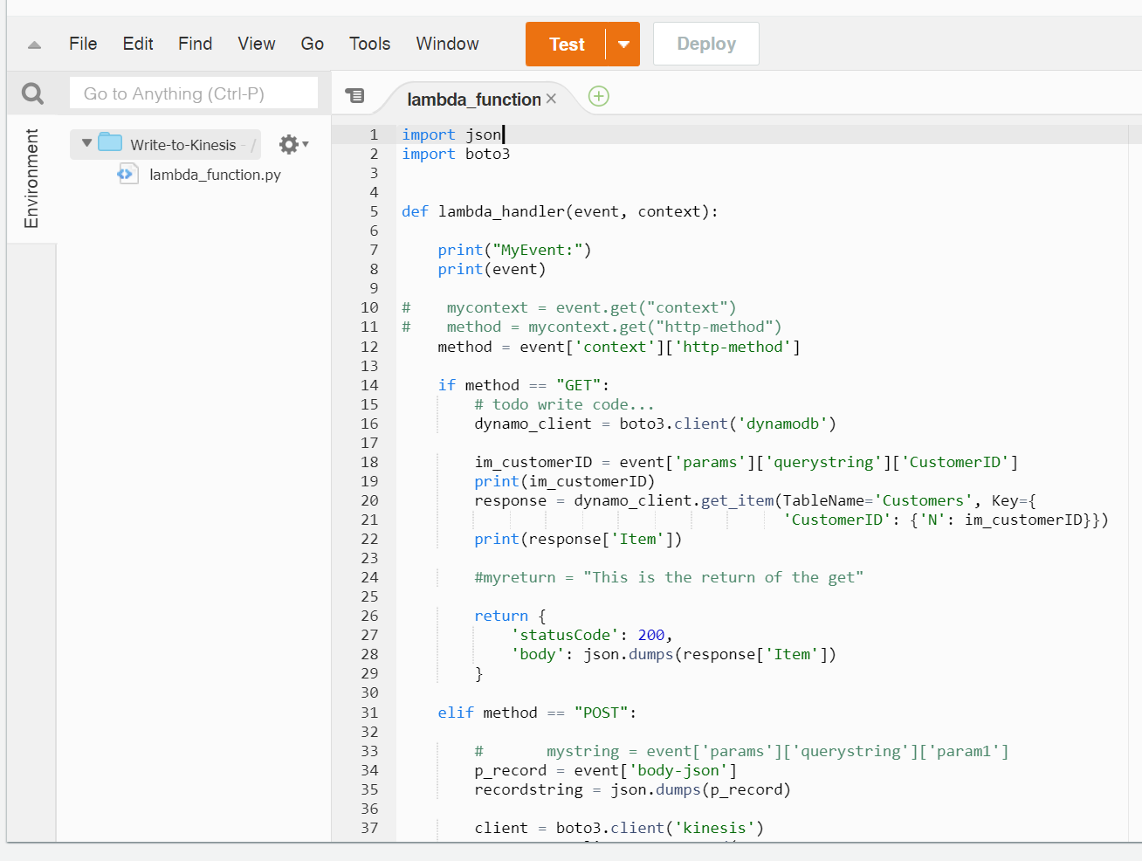
AWS Lambda Function

Slide 7
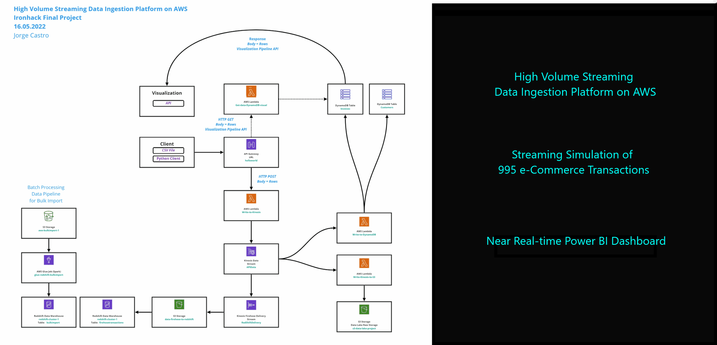
Demo Near Real-time data Stream Dashboard on Power BI

Slide 8
Wrap-up Issues and blockers

Slide 9
Q&A

